Slide 1
CAP6411
Logistics and SDXL-Turbo

Slide 2
Logistics
Go through the webcourse
Model efficiency will be the #1 factor to put into practice
Speed
Memory efficiency
Assignment 0
CAP5415 is a hard pre-requisite
Exceptions:
…
8/26 football day – no class
9/28-10/5 -- Prof at conference, team project week

Slide 3
Ground Rules, No Exception
Emailing me or grader that your submission is late for reasons like:
"The webcourse submission hangs"
"I was running only 1 minute late"
etc., etc.
We will NOT respond, and your assignment will be given an immediate zero point if we receive such an email from you
If you email me or grader your assignment instead of submitting to webcourse
Your assignment will be given an immediate zero point
No exception
If your submission includes any links of any kind (google doc, etc.)
Your assignment will be given an immediate zero point
No exception

Slide 4
Objectives of the Course
Learn various state of the art techniques in AI and computer vision while applying techniques and ideas towards novel contributions while enhancing:
Speed of model
Memory-efficiency of model
As you learn about all the modern models, you will demonstrate innovation in creating efficient version of these models
Assignments will emphasize on this

Slide 5
Team Project
Team of 4-5
Please socialize yourself to form a team
Assignment 1: Team formation, due 8/22, submit a pdf of you and your team members per student to webcourse, 10/10 points
Project list (model efficiency, innovation/novelty, implementation):
Text to 3D (https://objaverse.allenai.org/) [1]
Text to longer video with
Auto-regressive (https://sites.research.google/videopoet/) or [2]
OpenSoRA-Plan (https://github.com/PKU-YuanGroup/Open-Sora-Plan) [3]
Video-Text model (https://github.com/PKU-YuanGroup/Video-LLaVA) [4]
Text to ego-centric driving video (https://www.nuscenes.org/) [5]
Streetscapes->ego-centric video route (https://arxiv.org/pdf/2407.13759v1) [6]
Memory and speed efficient large models (https://arxiv.org/pdf/2205.14135) [7]
Each of above can have maximum of two teams

Slide 6
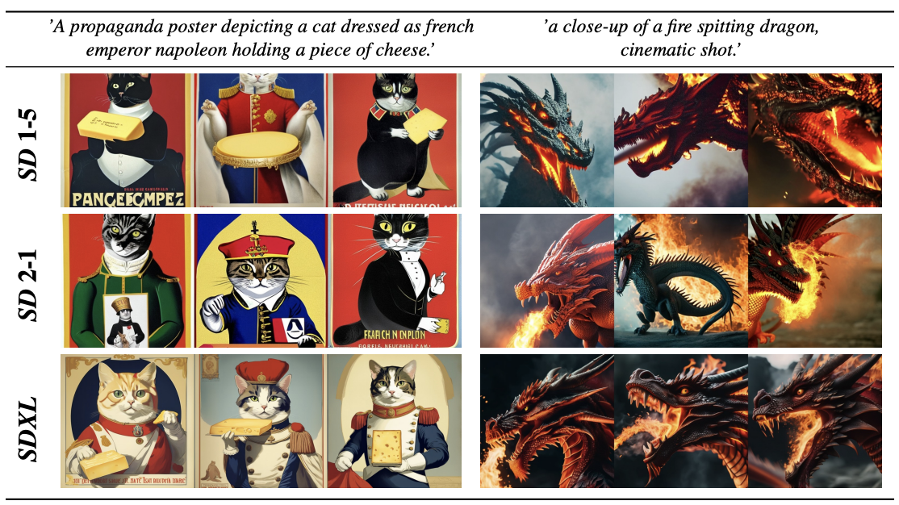
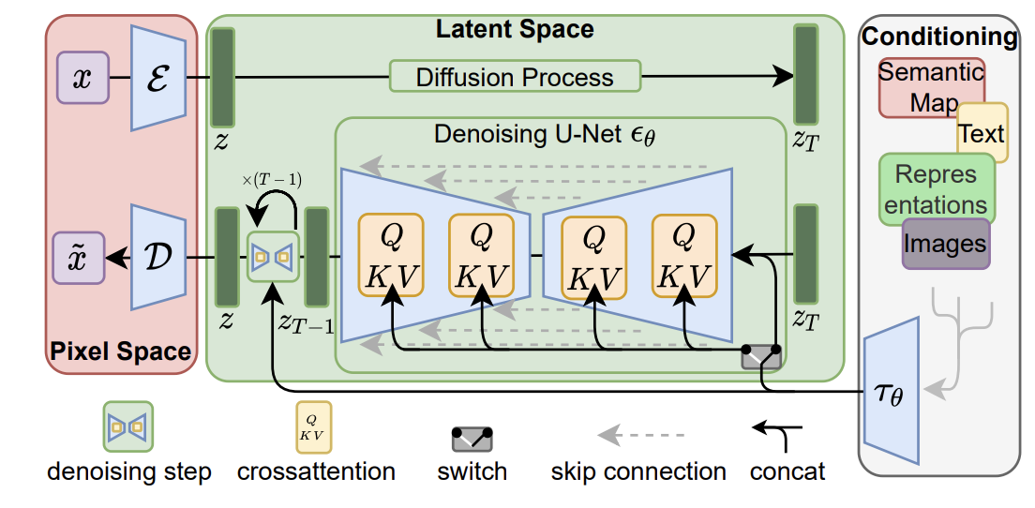
First Example of Making Model more Efficient – SDXL Turbo
SDXL (Stable Diffusion XL)
A diffusion model that can generate an image given a text prompt
1000 steps, very slow

Slide 7
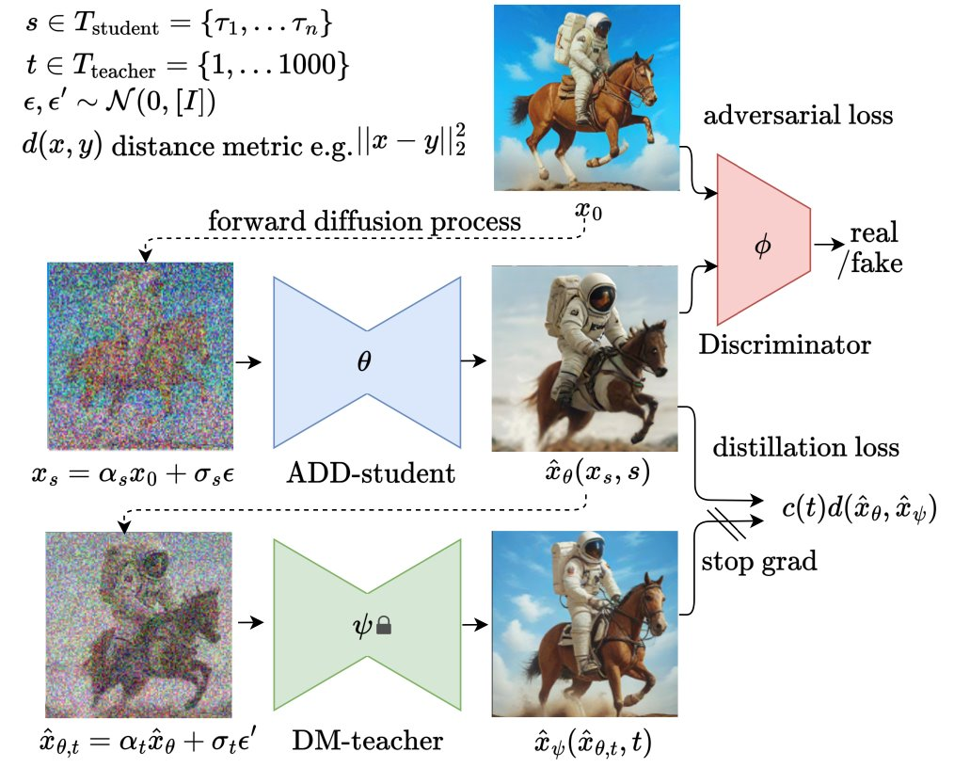
SDXL TURBO
Goal: reduce that 1000 steps into 1-4 steps
Sure, you can do that, but the quality won't be good!!
Therefore:
Use distillation: learn from the teacher (aka, the original SDXL model)
Use adversarial to ensure that the student produce images close to originals' quality
Zero terminal SNR
Ensure training and testing distribution are the same

Slide 8
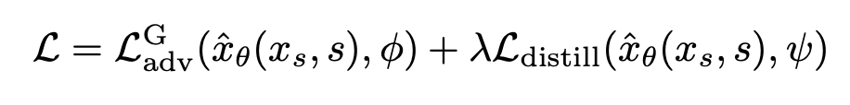
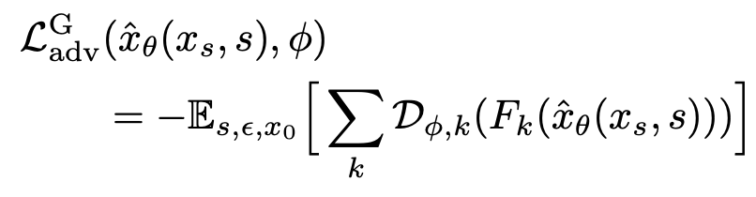
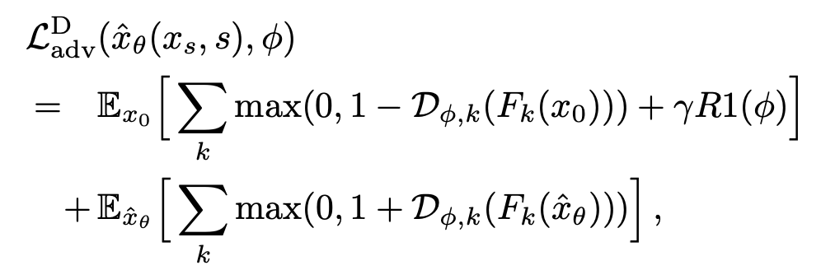
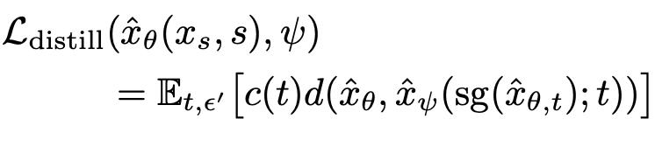

SDXL TURBO

Slide 9
Assignment 2
https://huggingface.co/datasets/Gustavosta/Stable-Diffusion-Prompts/viewer/default/test
Go to the "People" section in the webcourse
If you are the first student, for example, you will take the first 10 prompts from above link, second student will take the 11-20th prompts in the list and so on
Run SDXL Turbo and SDXL on those prompts assigned to you
Compare both models with two metrics
FID
Speed
Report due 8/27
8/22 will be given to work on the assignment
This is a system class with a lot of assignments, so some class days will be given to working on your assigments and your team project

